Slide 1

Bank Marketing Campaign Predictive Analysis

Slide 2

Predicting Term Deposit Account Openings in Response to Telemarketing Calls
This project uses data science to predict which customers are likely to open term deposit accounts based on telemarketing data.
Term Deposit Account (Certificate of Deposit/CD):Type of account which cash deposit remains in the bank for a specific time period for an agreed rate.

Slide 3

Business Objectives
Cost Reduction:
Telemarketing Cost: Bank pays internal employees or 3rd party call centers to conduct the marketing calls, therefore it is essential to target customer with higher chance of opening deposit
Reducing the number of calls made to uninterested or unsuitable prospects
Minimizing the number of unproductive calls helps in reducing wastage of human and financial resources.
Increased Conversion Rates | Increase ROI (Return On Investment)
Enhanced Customer Experience (CX):
Increase customer satisfaction rate (CSAT)
Customers more likely to respond positively to calls that address their needs and interests
Strategic Alignment
Market Positioning

Slide 4

Utilize Data Insights for Business Metrics
Enhance The Efficiency and Effectiveness of Telemarketing Campaigns
Develop a predictive model using historical data.
Identify key factors that influence customer decisions.
Provide actionable insights to marketing and sales teams.

Slide 5
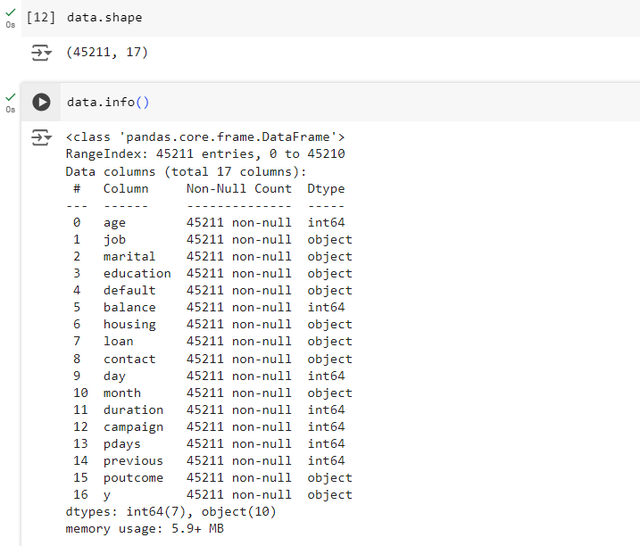
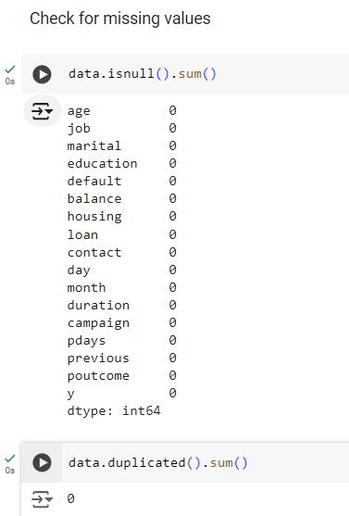
Data
"We used historical telemarketing data, including customer demographics, past interactions, and outcomes of previous marketing campaigns."

Slide 6
Data
 | Field/Column | Description of field data | Type
Demographic Data | age | Age | Integer
 | job | Job | Categorical
 | marital | Marital Status | Categorical
 | education | Education Level | Categorical
Banking Data | default | Default Payment: Failed to make a payment | Binary
 | balance | average yearly balance | Integer
 | housing | Own vs Rent (Do they have a housing loan) | Binary
 | loan | Do they have a loan with bank or not | Binary
Current and Previous Campaign Data | contact | Contact Method | Categorical
 | day | Last Date of contact with client (day) | Date
 | month | Last Date of contact with client (Month) | Date
 | duration | Duration of call in seconds | Integer
 | campaign | number of contacts performed during this campaign and for this client | Integer
 |  | (includes last contact)
 | pdays | number of days that passed by after the client was last contacted from a previous campaign | Integer
 |  | ( -1 means client was not previously contacted)
 | previous | number of contacts performed before this campaign and for this client | Integer
 |  | 0 means this client was not contacted in previous campaign
 | poutcome | Result of previous campaign | Categorical
 | y | Client opened a Deposit Account | Binary

Slide 7
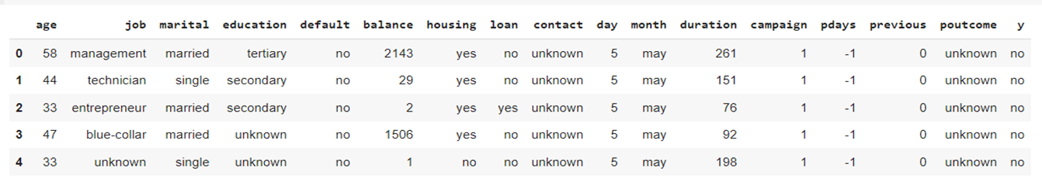
Data
Rename
campaign ----> contact_count
previous ----> p_contact_count
y ----> target
New Features Defined
first_campaign: if the customer hasn't been contacted in previous campaigns (pdays=-1) then first_campaign='y' else ‘n’
pdays_group: Group pdays into 90 days interval (every 3 months) and those with pdays=-1 are categorized as "No Previous Contacts"

Slide 8
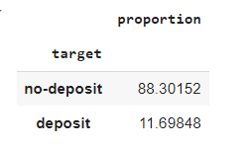
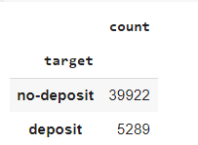
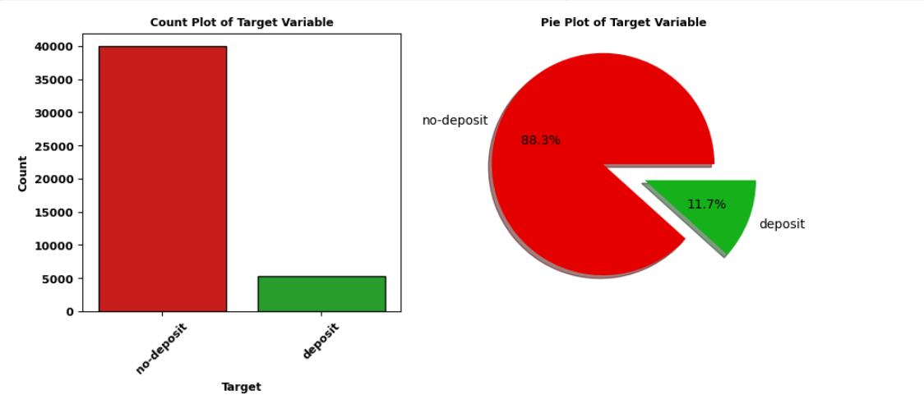
Target

Slide 9
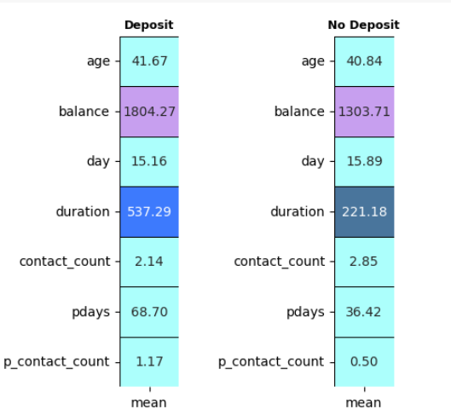
EDA: Numerical Features
duration of call for those who opened a deposit account are much higher 538 vs 222
those customers who opened a term deposit normally have a higher avg balance $1800 vs $1300
Average or Mean of age are very close for both
Majority are similar except pdays.

Slide 10
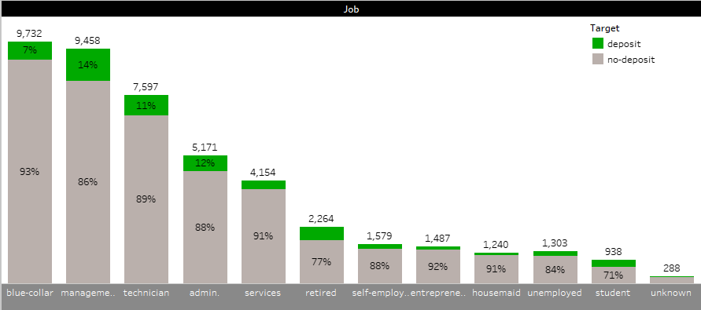
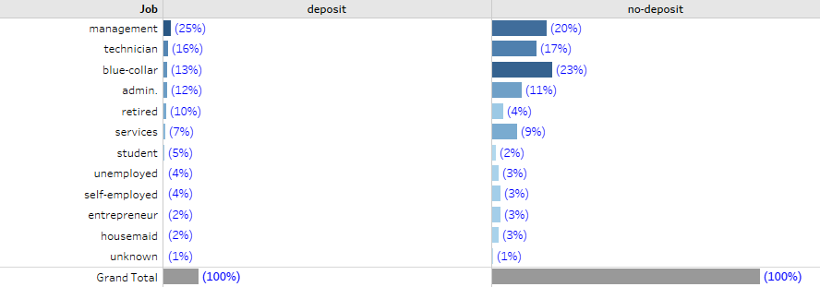
EDA :Categorical Features
Job
Majority of people who opened deposits are in management and technical positions.
Within each job category, students and retired people showed the highest interests (29% and 23%)
Blue-collar and entrepreneurship have the top 2 high rejection rate (93% and 92%), followed by housemaids and people in services

Slide 11
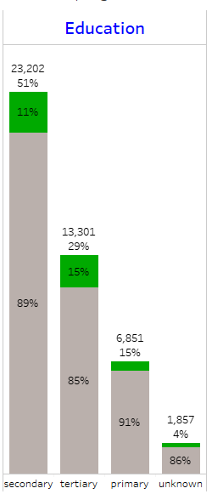
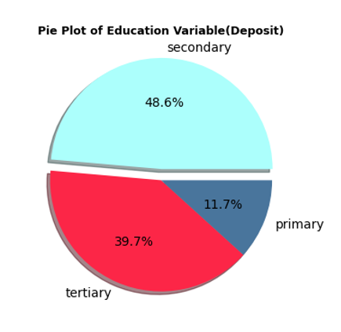
EDA
Education
Unknown Education acts like missing value since it is a small% of total data. However, if we have a very small sample size, we should keep this value
Almost half of our clients with deposits have secondary education

Slide 12
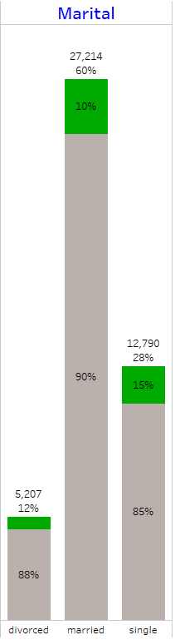
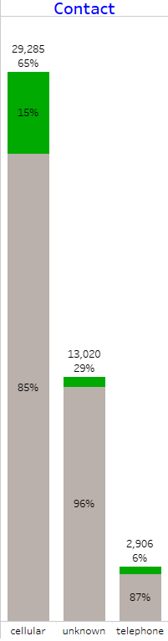
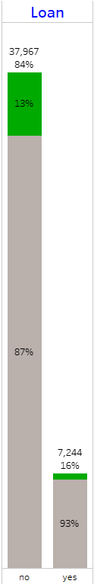
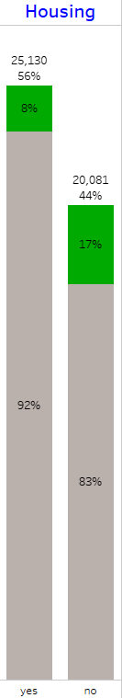
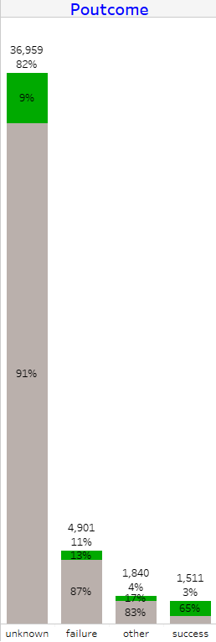
EDA

Slide 13
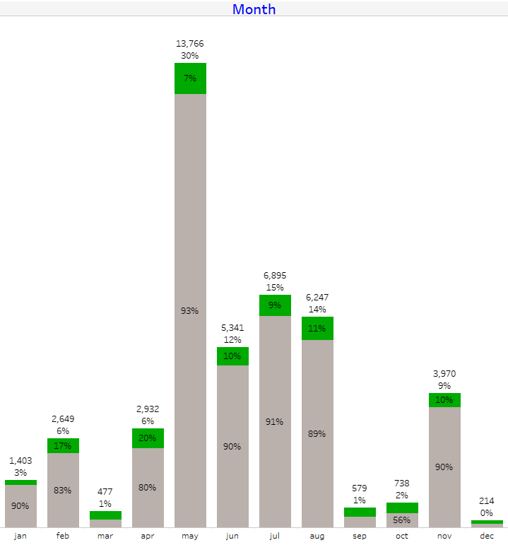
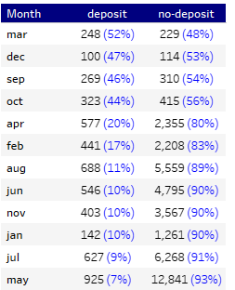
EDA
Even though majority are calls are conducted in summer, looks like March, December and September can also be good considerations for calling clients.

Slide 14
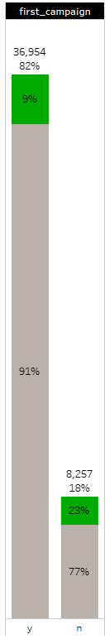
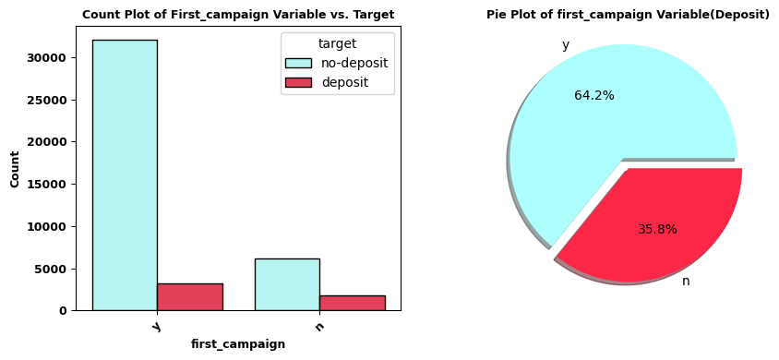
EDA
First Campaign

Slide 15
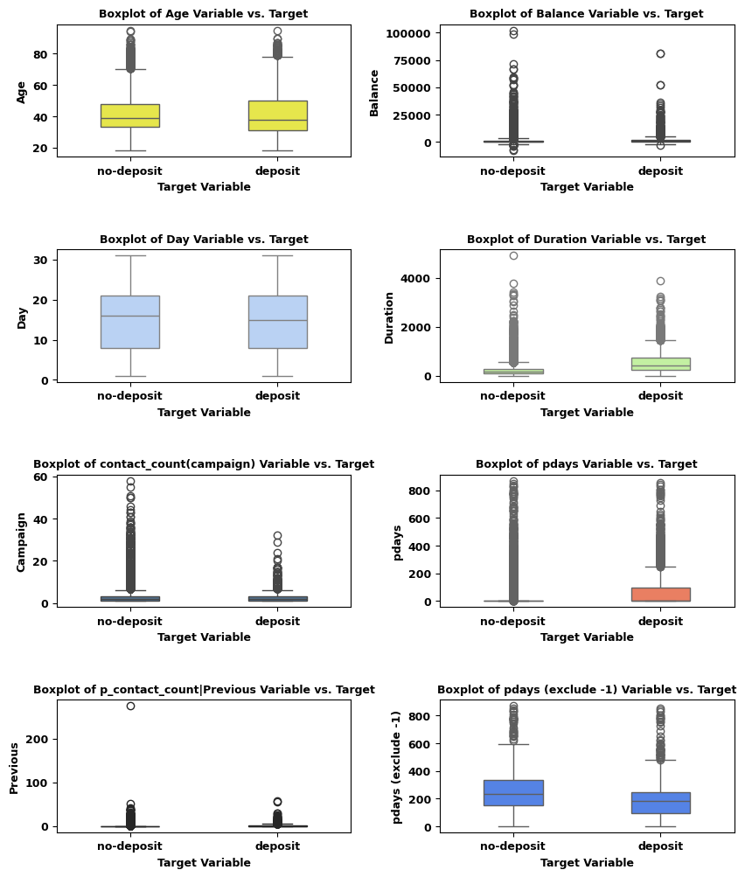
EDA

Slide 16
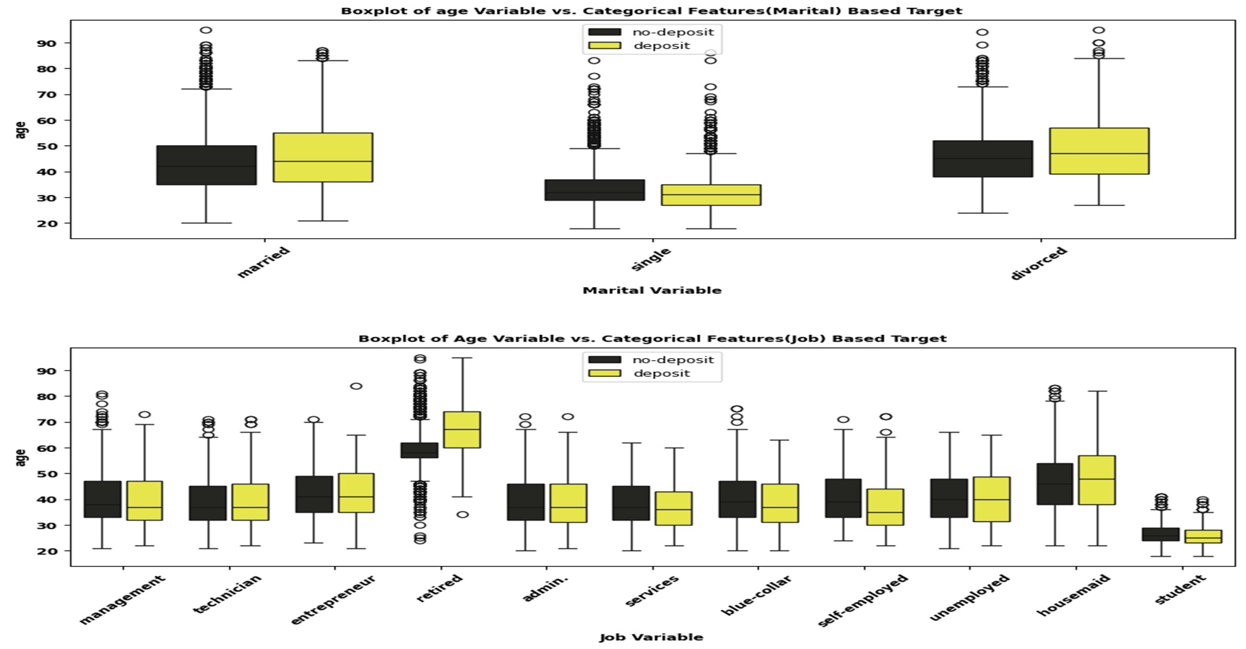
EDA

Slide 17

Feature Scaling
Normalize or standardize the range of features
Ensure that all features contribute equally to the model's decision-making process
Scaling:
RobustScaler : resistant to outliers
StandardScaler

Slide 18
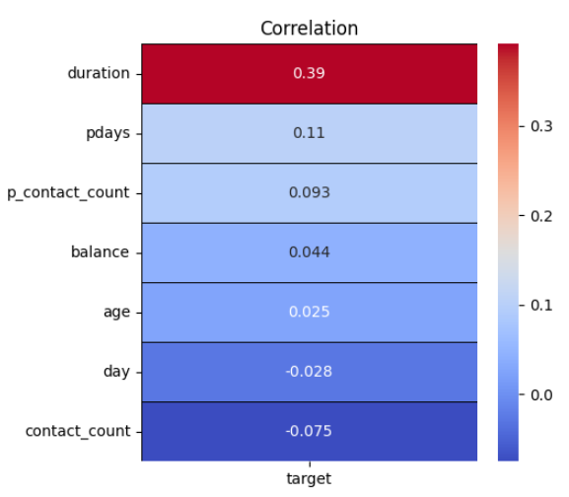
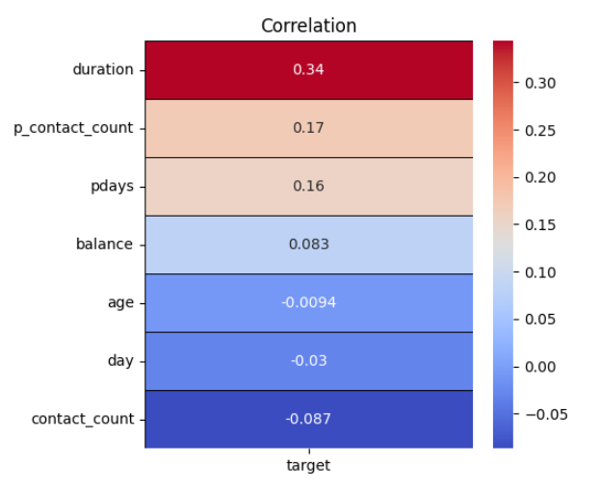
Correlations
Pearson
Spearman

Slide 19
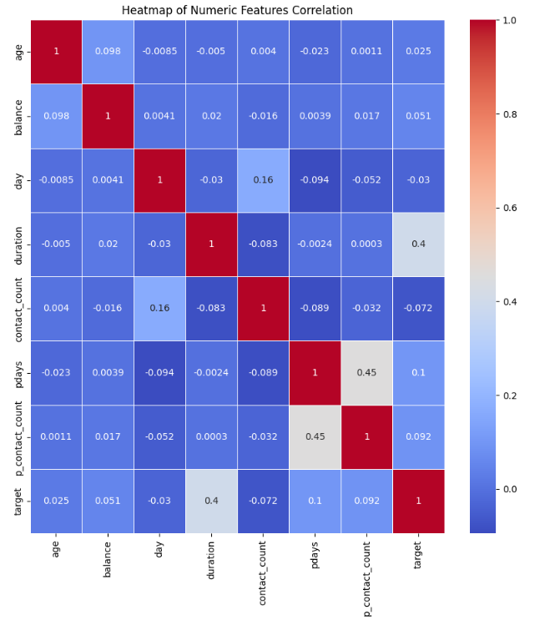
Correlations

Slide 20
Correlations
Cramer’s V
Cramer's V for 'job': 0.13
Cramer's V for 'marital': 0.07
Cramer's V for 'education': 0.07
Cramer's V for 'default': 0.02
Cramer's V for 'housing': 0.14
Cramer's V for 'loan': 0.07
Cramer's V for 'contact': 0.15
Cramer's V for 'month': 0.26
Cramer's V for 'poutcome': 0.31
Cramer's V for 'target': 1.00
Cramer's V for 'pdays_group': 0.20
Cramer's V for 'first_campaign': 0.16

Slide 21
Features Selection
Selected Features for Modeling
'job’,
'housing’,
'contact’,
'poutcome’,
'month’,
'target’,
'duration’,
'p_contact_count’,(previous)
'pdays'
Converting categorical features to numerical using LabelEncoder

Slide 22
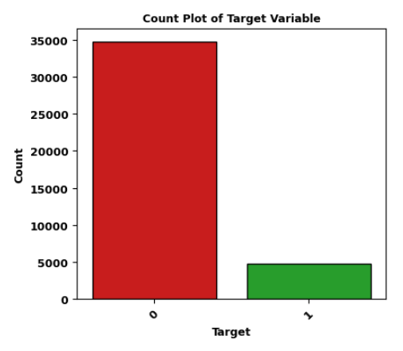
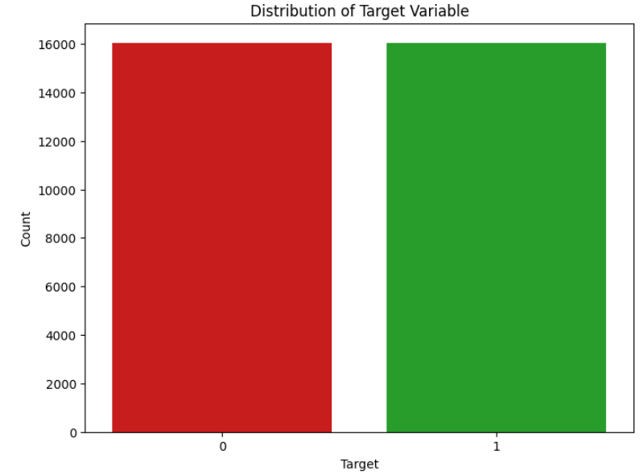
Balancing

Slide 23
Modeling
Logistic Regression
KNN
Random Forest
Gradient Boosting Classifier
eXtreme Gradient Boosting Classifier

Slide 24
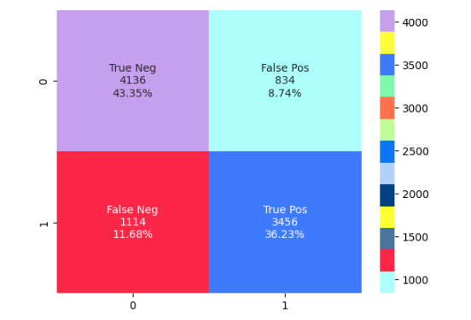
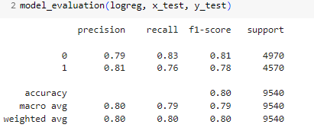
Logistic Regression
Best Parameters: {'C': 1.0, 'penalty': 'l1', 'solver': 'liblinear'}
Test Score (Accuracy): 0.7952830188679245

Slide 25
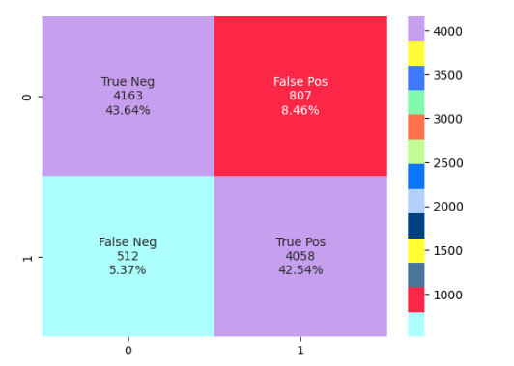
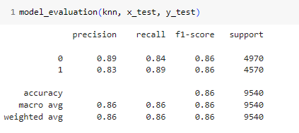
KNN
Best Parameters: {'algorithm': 'ball_tree', 'n_neighbors': 9, 'p': 1, 'weights': 'distance'}
Test Score (Accuracy): 0.8617400419287212

Slide 26
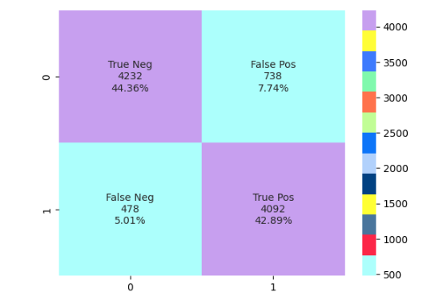
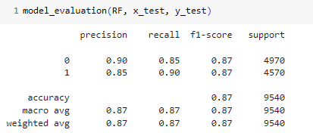
Random Forest
Best Parameters: {'max_depth': None, 'min_samples_leaf': 2, 'min_samples_split': 10, 'n_estimators': 200}
Test Score (Accuracy): 0.8736897274633124

Slide 27
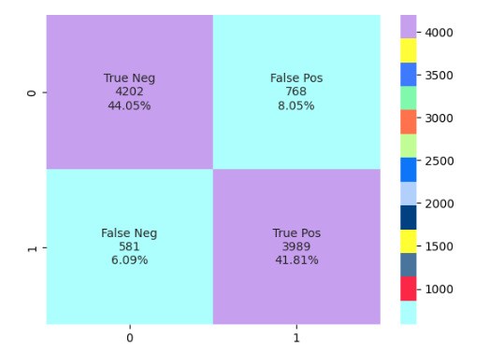
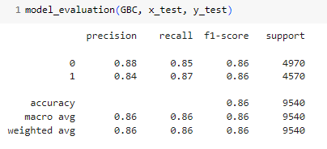
Gradient Boosting Classifier
Best Parameters: {'learning_rate': 0.1, 'max_depth': 4, 'min_samples_leaf': 1, 'min_samples_split': 2, 'n_estimators': 100}
Test Score (Accuracy): 0.8576519916142558

Slide 28
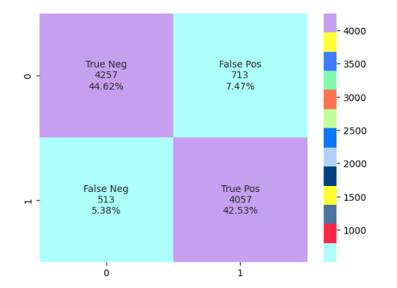
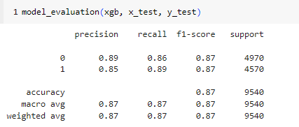
eXtreme Gradient Boosting Classifier (XGBC)
Best Parameters: {'colsample_bytree': 1.0, 'learning_rate': 0.2, 'max_depth': 5, 'min_child_weight': 4, 'n_estimators': 200, 'subsample': 0.8}
Test Score (Accuracy): 0.8710691823899371

Slide 29
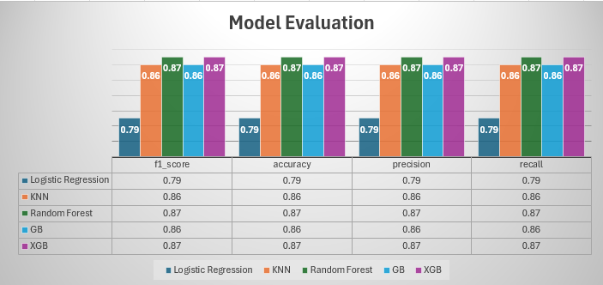
Model Evaluation
Model Performance:
"Our best models (Random Forest and XGB) achieved an accuracy of 87%, with a precision of 87% and a recall of 87%.“
Random Forest accuracy is slightly higher with type I error slightly lower.

Slide 30
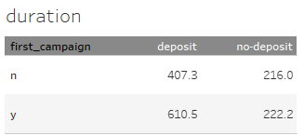
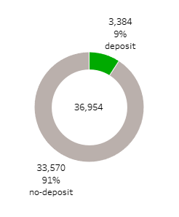
Recommendations
Data Collection: It could have been helpful to have the final deposit amount for those clients who opened a term deposit account. We recommend capturing that data for future campaigns.
It is suggested to have longer conversations and probably focused on how the client can benefit from term deposit. More specifically, by looking at the average duration of call for both groups, we notice those customers who are being contacted for the first time may require more information and more time on the call.

Slide 31

Feedback

Slide 32
THANK YOU

